Slide 1
Applying evolutionary principles to tumor biology

Slide 2
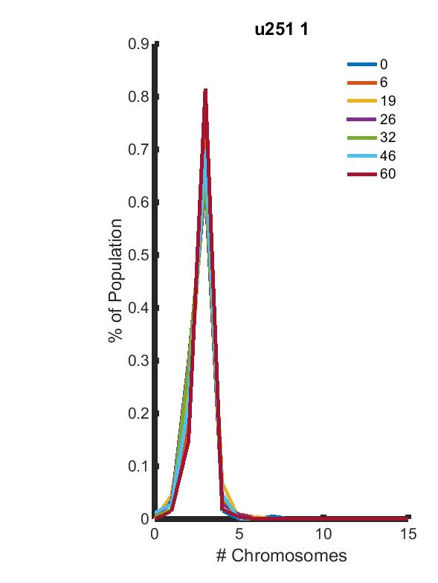
Tumor heterogeneity affects patient outcome and resistance
CIN chromosome distribution over time
CIN = high rate of chromosomal missegregation
  Fitness of subclones varies with karyotype
Model population fitness to better understand treatment failure?

Slide 3
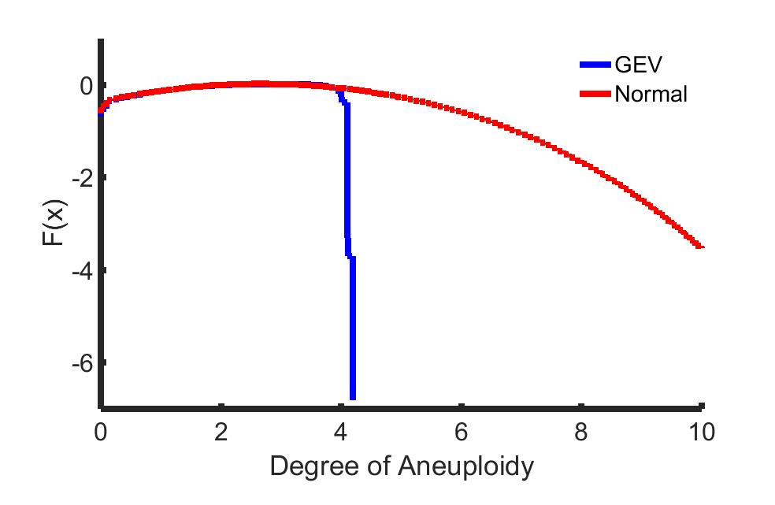
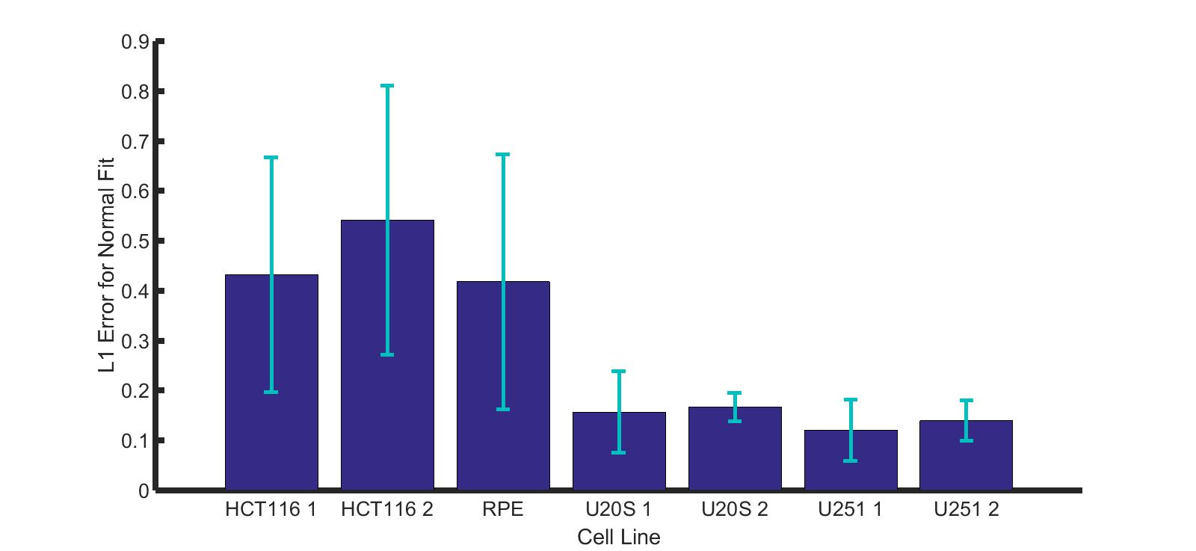


CIN fitness distribution can explain heightened antimitotic drug tolerance
Developed model for phenotypic fitness prediction
Less fitness variation in CIN lines
Non-CIN
CIN

Slide 4
Expanding projects to track tumor dynamics
Identifying variant reads from NGS data that predict altered protein activity
Determining RNA source in ‘liquid biopsies’ of cancer patients
  Tracking tumor evolution and drug response
Predicting future tumor evolution trajectories

